Slide 1
GUIDE FOR THE IMPLEMENTATION OF THE
“BASIC FORMATION CYCLE”
EVANGELICAL SOLIDARITY
2013-2016

Slide 2
THE HOLY SPIRIT
With his Gifts designs the variety which is the Richness of the Church... The Temple of the Holy Spirit. Temple in which God works, the Temple in which, with the gift of Baptism, each one of us is a living stone.
<<Francis>>

Slide 3
The Basic Formation Cycle (BFC), is the main resource used by the Christian Family Movement (CFM) in Mexico and in 13 other Latin America countries, for the formation of its members, and it is shared in this project to join efforts and contributions from other member countries.

Slide 4
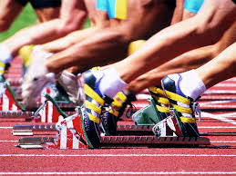
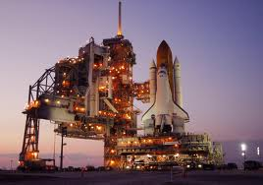
However this is not intended to be a complete formation program but provides the basic elements of integration and maturity at personal, marital, family, and community levels. This is a take-off platform.

Slide 5
The formation consists in three "phases". The first phase is the "pre-registration". The second phase is the “Basic Formation Cycle” (BFC) with a 3 year duration. And a third phase, “deepening” which is the apostolic activity and/or service, after the previous two phases.
Profundization Phase
3rd Level
2nd Level
1st Level
Pre-registration
Formation Phase (BFC)
Information Phase

Slide 6
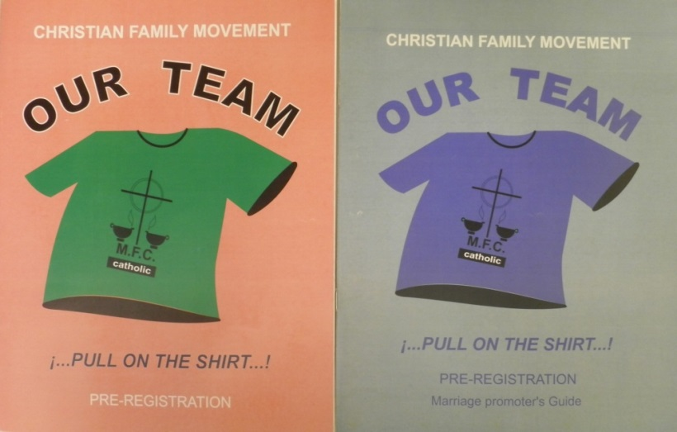
The pre-registration stage is informative. It consist in three meetings using the book "Our team" that pretends to introduce the CFM to the new prospect member marriages. The pre-registration stage takes place just before the beginning of the BCF and after the “fishing” of new members .
There is a book an a guide for the promotor marriage
All families interested in being part of the BFC of the CFM, must know this first stage.

Slide 7
The BFC has a duration of three years. At the end of the first year or "level", if the marriage had a minimum attendance of 80% can be registered to the next level.
The study calendar is from September of one year to June of the following year, as it seeks to match the 3 liturgical moments (Advent-Christmas, Lent-Easter, and Pentecost). However, if the issues can be fit, other 10-month period can be chosed. But it is essential that all teams of the three levels, begin and end at the same time.
80%
80%
80%
3rd LEVEL
2nd LEVEL
1st LEVEL

Slide 8
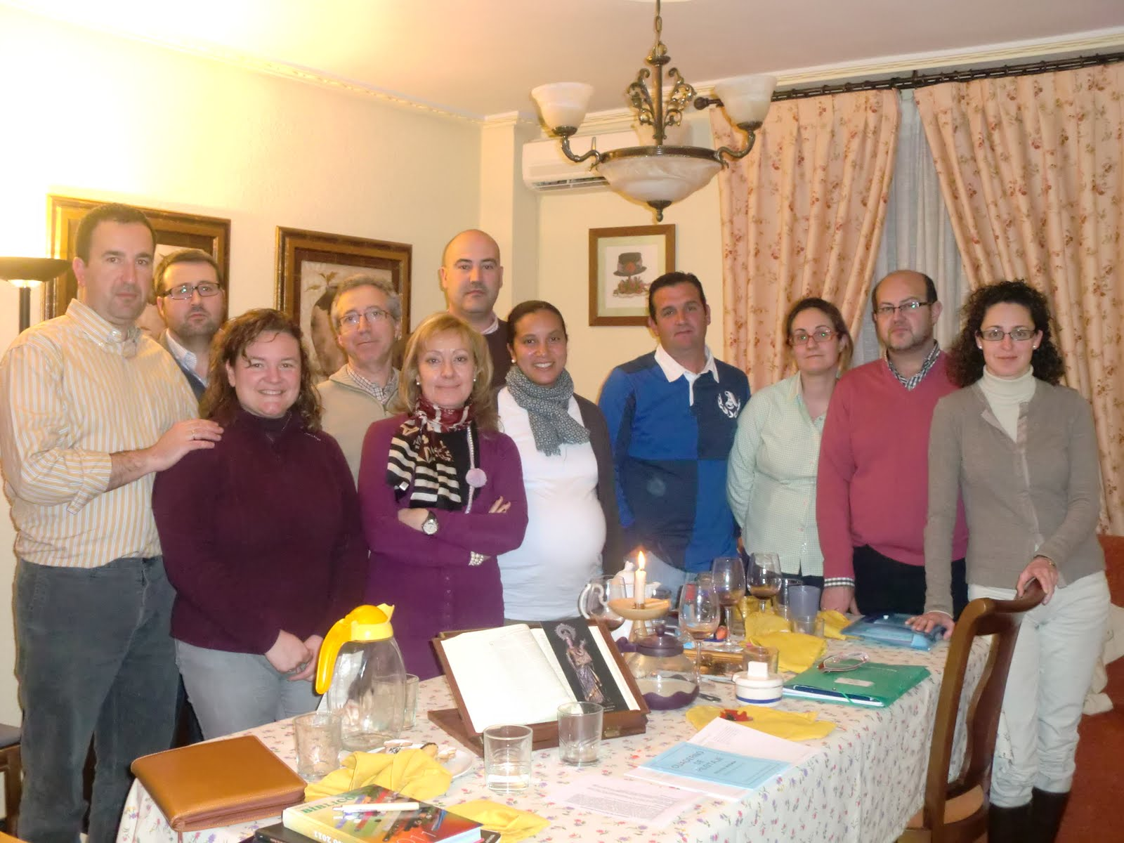
To live the experience of the BFC, is necessary to create the "basic teams" composed of 4 to 7 marriages coordinated by a “Promoter marriage of basic team" with previous experience on it. The teams meet every other week on the day and hour previously agreed and in their own homes, in a rotating basis, so that everyone has the opportunity to live the Gospel value of hospitality. The formation meetings have a duration of 2 hours approximately.

Slide 9
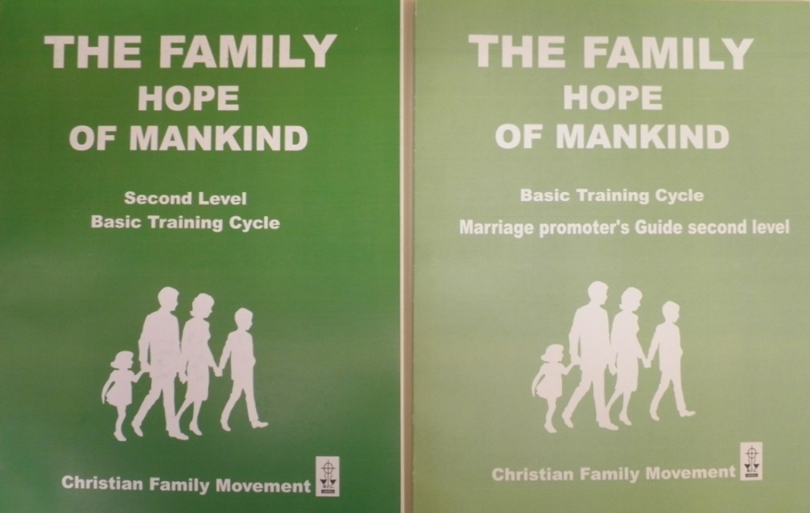
At each meeting we review a theme of the book previously supplied. The promoter marriage has in addition, a book "Guide" to coordinate the meetings.
The promoter marriage meets his zonal team to prepare the next topic, "living it" with this team too, every two weeks.
There is a book an a guide for each year or level

Slide 10
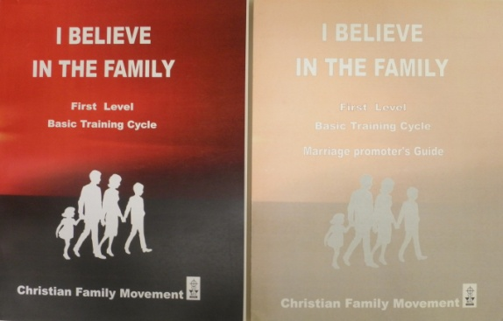
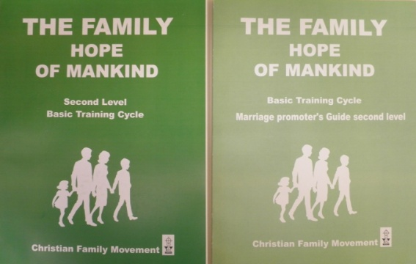
The BFC books constitute the most important tool for the training process. Each book consist of 17 themes, and they together form a system, and collect the fundaments of what our faith says about the family treasure. The themes are presented in an orderly, gradual and logic way. They are structured to be reviewed with the logic of the See - Judge - Act. The books are strongly inspired by the Bible and the Magisterium of the Church. The books and themes should be studied one by one, respecting the order.

Slide 11
The method for the study of themes, consists of on 4 steps.
1st Personal reading. Each of the spouses reads the corresponding theme and at the end answers the questions of the "personal reflection".
2nd Conjugal dialogue. Once the two have read the themes, they should look for an appropriate time to share and respond "conjugal reflection"

Slide 12
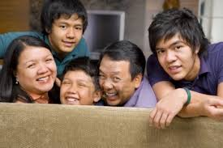
3rd Family dialogue. Parents share with their families what are learning and they do perform the dynamics from the family "reflection”, of the book.

Slide 13
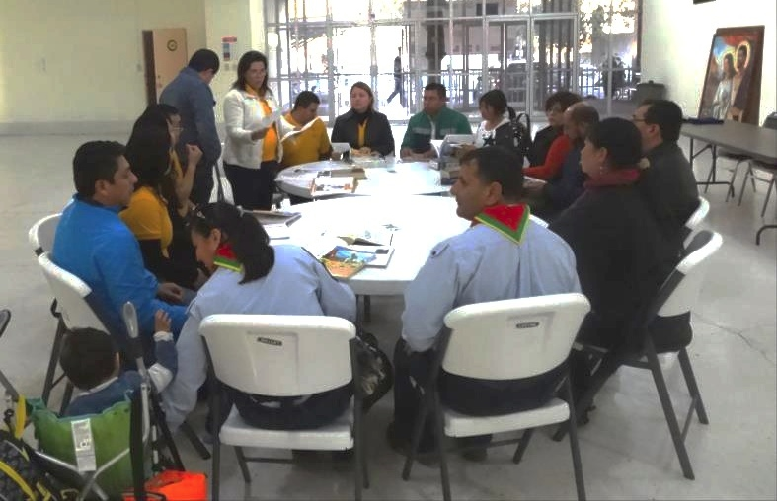
4th Study in team. This fourth moment is dialogue with the basic equipment the day of the meeting, guided by the promoter marriage.
The theme is not literally read, but it is commented by paragraph or by section, what seems to be more relevant for each one. The promoter seeks the equal participation of all, trying not to stray too far from the topic.

Slide 14
Suggested action. At the end of each theme, as part of the 'act', is a suggested action, agreed by all in the group.
It is the way to go from the ideas to the practice. In such way that the change of life go to reality.
The agreed action should be achievable, measurable, and positive. At the beginning of the following meeting will be a short time to share freely as we were during the fortnight.

Slide 15
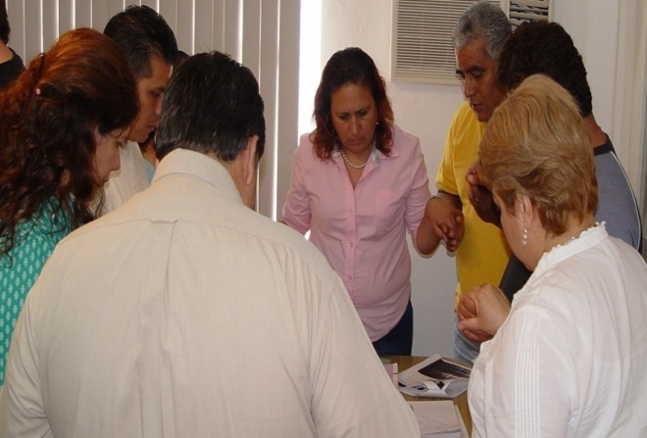
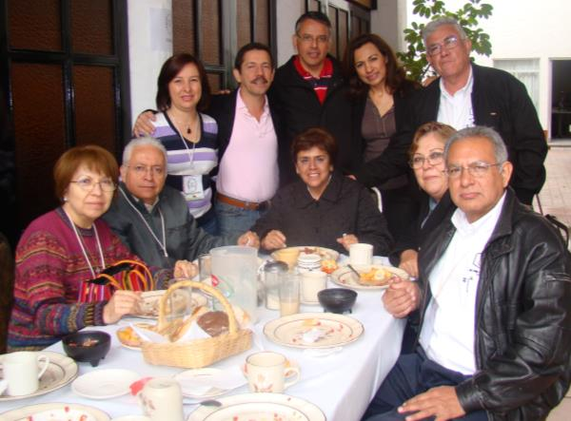
Prayer. All meetings begin with the invocation to the Holy Spirit and are finished with a community prayer on the book, this prayer is related to the topic of the meeting. During the formation we are constantly invited to participate in the personal, communal and liturgical prayer.
Hospitality. Another pillar of the formation is the hospitality, that is the reason why meetings are held in our homes. It is common that after the meetings of study, a simple meal which should be “simple” is offered with no alcohol drinks.

Slide 16
SERVING
As part of formation, the BFC is promote, since the first level, to all marriages to integrate to provide a service for the common good in their community (neighborhood, school, parish, family, etc.).
16

Slide 17
SUMMARIZING:
RESULT | TO ANNOUNCE AND BUILD THE KINGDOM OF GOD
Means | Community (that little Home Church that is the family and that community of life that is the basic team) | Formation (The Kingdom is announced, but first is discovered and understand in the formation) | Social Commitment (The Kingdom is built promote peace and justice from the family) | Prayer (the Kingdom is celebrated in the liturgy, the popular religiosity and in the personal prayer)
Basic requirements of the CFM | Team life Hospitality | Study | Christian use of material goods Service Commitment | Prayer life
Fundamental Tool | Dialogue with the basic equipment | Conjugal dialogue, with family and with basic equipment | Dialogue with society | Dialogue with God

Slide 18
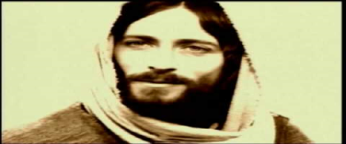
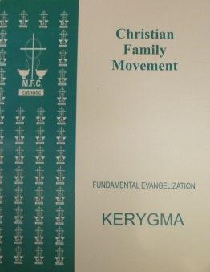
In addition to the subjects and meetings there are other very important elements that are part of the formation of the BFC.
STRONG MOMENTS. Each year, phase or "level", the experience of a “strong moment” is included.
Usually a weekend is designated to live this “encounters”
First level
KERYGMA, Fundamental Evangelization
Second level
Marriage Encounter
Third level
Family Encounter
There is a “manual” for the development of each of these encounters.

Slide 19
Another important element of the formation are:
General Meetings. During the year, there are three meetings in which all marriages from all the basic teams attend, and where is celebrated the liturgical times of Advent-Christmas, Lent-Easter and Pentecost. General meetings are an important part in the formation of the BFC, they foster the personal relationships, sense of community, contagious enthusiasm of the “movement” and developing a sense of liturgical prayer and church.
On the Descriptive Charts there is a description of how to organize each General Meetings.
 | ADVENT-CHRISTMAS | LENT-EASTER | PENTECOST
VIRTUES | faith | hope | charity
APPROACH | family | marriage | community
MACRO VALUE | faith | conversion | service
AMBIENCE | celebration | reconciliation | prayer

Slide 20
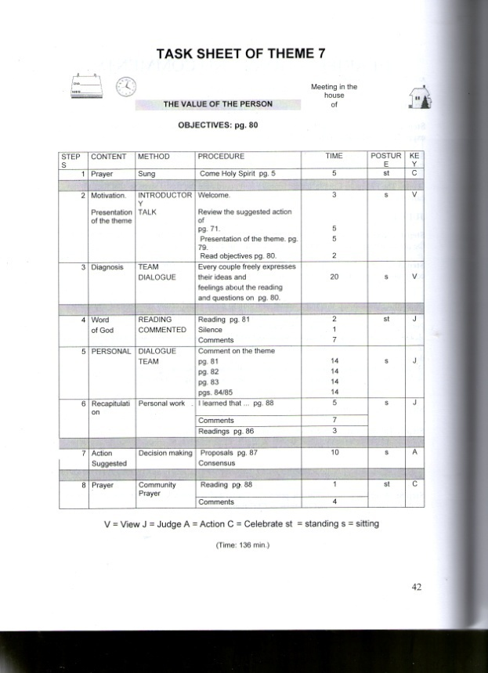
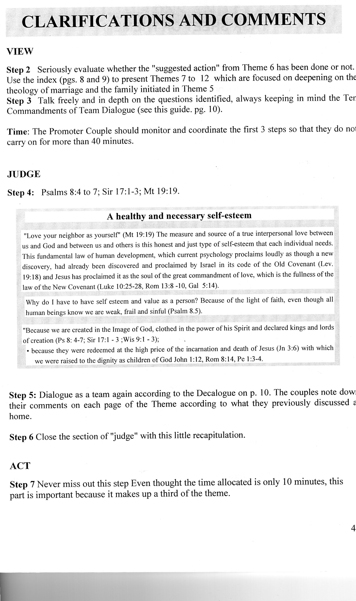
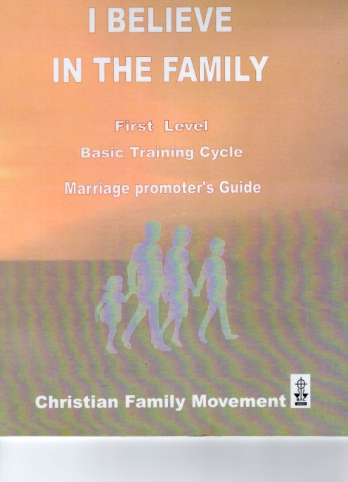
The "Promoter marriage Guide," contains a "descriptive letter" for each theme, which says step by step, how to manage the meeting, the time control, supporting material, etc. Also it contains further information that can lead the promoter. It is essential to follow the descriptive letter. The promoter marriage must study it previously and the right moment for this is the “Zone meeting”.

Slide 21
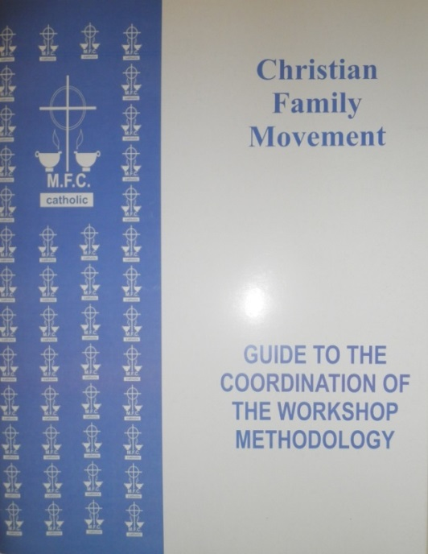
Workshop of Methodology
There is a training course called "Workshop of Methodology" which had been developed as a tool to the promoters, so they can properly implement the "descriptive letter" and deepen on the elements of technique, mystique and ambience; they are the basic elements of the CFM pedagogy.
There is a ppt presentation, the book guide, a DVD with the picture, and the elements necessary for the dynamics.

Slide 22
Zone.
When several teams already exist within the same year or 'level', it is convenient to group them to form a “Zone".
By definition is a grup of basic teams in the same level or year and of a certain geographical area, is a Zone.
The Zone is coordinated by the Zonal team.
The Zonal team is composed by:
A “zonal promoter marriage”.
All promoter marriages of basic team in the zone, in the same level.
The Zonal Ecclesial Assistant.

Slide 23
Zonal promoter
First level
Ecclesial assistant
Team 1 Promoter
First level
Team 2 Promoter
First level
Team 3 Promoter
First level
Team 4 Promoter
First level
ZONE AND ZONAL TEAM
Team members
Team members
Team members
Team members

Slide 24
ZONE
The zonal team meets every other week.
Its main functions are:
To have a living experience.. During this phase the team lives the theme as any basic equipment.
To evaluate the previous meeting. Using the report formats for the meetings of the basic teams.
The zonal team members training.
Planning of common activities.
General announcements.
The formation of the zone can be
adapted to your reality and necessity.
The Zone team is the main way to ensure that the “basic teams” “live” their meetings adequately and that their promoters are properly trained

Slide 25
Zone Team goals
That the basic teams of the zone work properly
Save diocesan unit
Live the BFC in a serious, responsible and quality manner
Create a Christian community of love, friendship and mutual aid
25

Slide 26
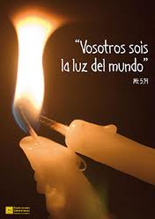
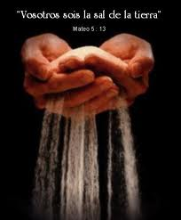
At the end of the basic formation course, it is important to organize a meeting where we can recognize the effort of marriages in their formation, and encourage them intensely so that they would be integrated into an ministry. The following idea may possibly work:
If we have known Christ's light and we have had the opportunity to form us through the BFC, we have the commitment to reflect that light to our brothers, whether working as promoters for a new basic team or in an ministry in our parish or community.
“No one lights a lamp and hides it in a clay jar or puts it under a bed. Instead, they put it on a stand, so that those who come in can see the light”
Luke 8, 16

Slide 27
Promotor Marriage, FBC
Marriage Coursing the BCF
Marriage Coursing the BCF
Marriage Coursing the BCF
Marriage Coursing the BCF
Marriage Coursing the BCF
STRUCTURE del MFC
Basic Team
Zonal Team
This structure base on teams, helps to live the CFM Charism and meet their objectivs.
Sector Coordinator Team
Diocesan Coordinator Team
Nacional Coordinator Team
Continental President Team
International Confederation of CFM(ICCFM)
27

Slide 28
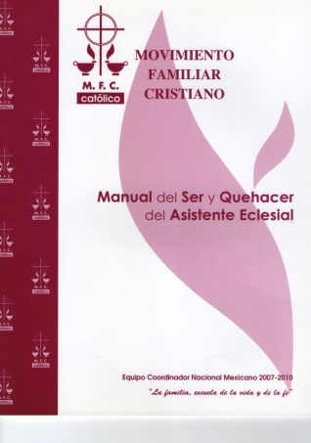
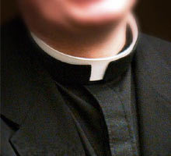
Ecclesial Assistant
STRUCTURE
Being a Church Movement, requires the assistance of priests or consecrated (as) to join him on their teams. The church attendance has been fundamental since the beginning of the Christian Family Movement. The Ecclesiastical Advisor helps families reach their goal :
Doctrinally illuminating issues of CBF.
Training the emefecistas as true agents of family ministry.
Accompanying the growth of the spiritual life.
Promoting internal and external unit CFM.
There is a Manual of the Ecclesial Assistant
28

Slide 29
When we talk about "structure", we are referring not only to the flowchart of the different positions, but all that clearly defines the roles, responsibilities, objectives, requirements, etc..
STRUCTURE
BYLAWS.
Is important that the CFM has defined :
Bylaws
Constitution
Identity Chart.
29

